Slide 1
PA Compression Test User Guide
Nick Lalic
VNA Software Developer
Rohde & Schwarz North America
April 4th, 2016

Slide 2
Sections
Hardware Configuration
Calibration
ZVAX Pulse modulator on
Pulse Gen: Constant High
Trigger: Free Run
One Path Two Port
Source Power Cal
Pulsed RF
Pulse Type: Single Pulse
Trigger: Rising Edge Pulse
Trigger measurement: Point

Slide 3
Hardware Configuration
Port1
Port2
S1
a1
b1
b2
a2
S2
Driver
DUT S(f, P_{in})
ZVAX
Calibration Planes
Power Cal. Plane

Slide 4
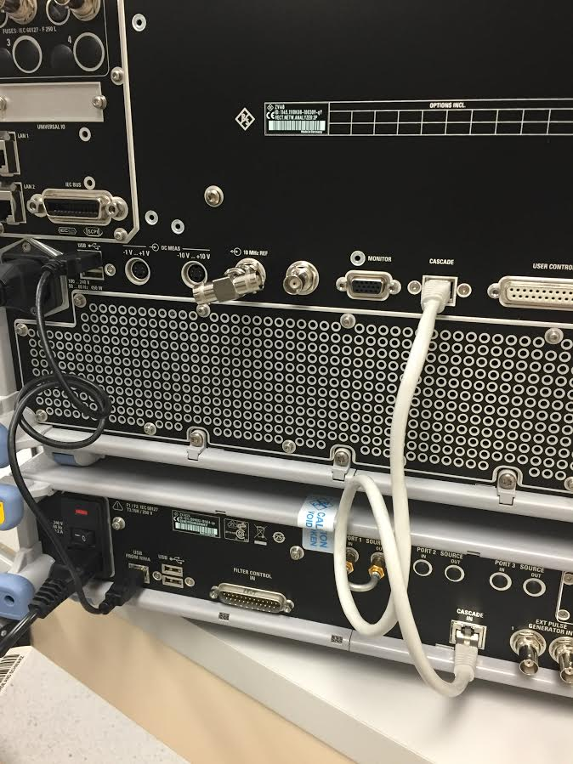
Hardware Configuration
Rear Connections
ZVA USB -> ZVAX “USB from NWA”
ZVA Cascade -> ZVAX Cascade In

Slide 5
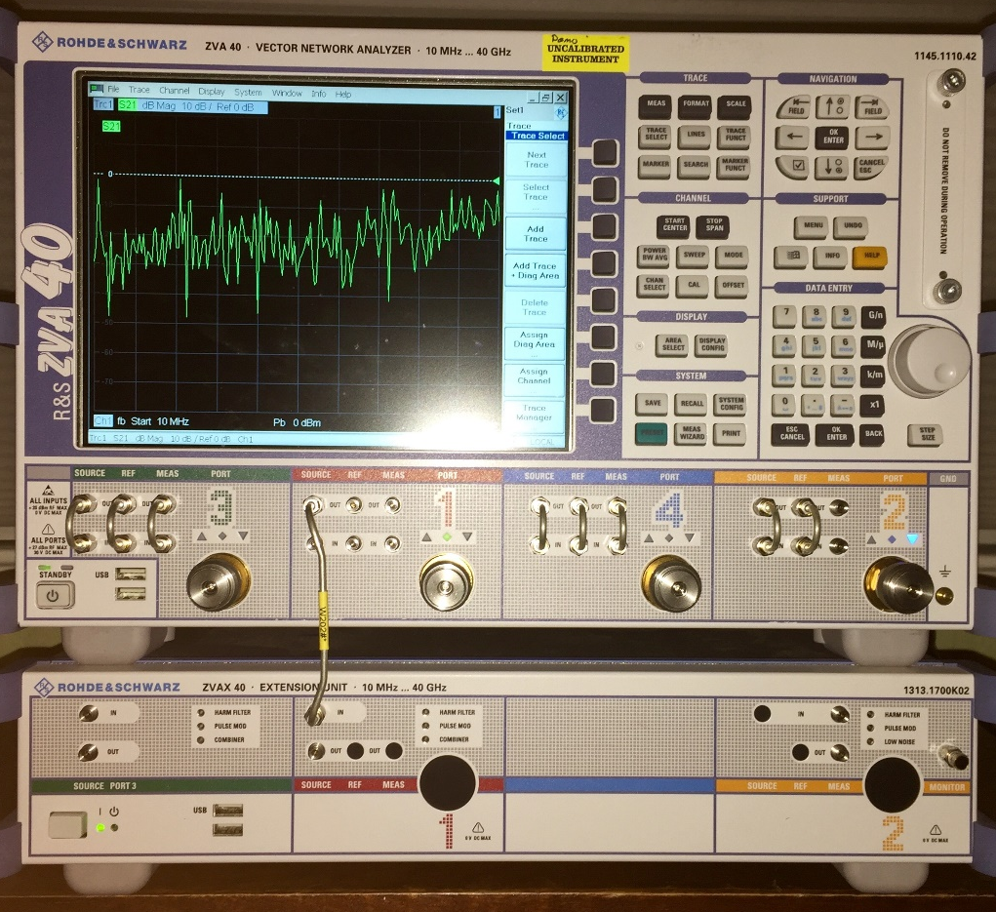
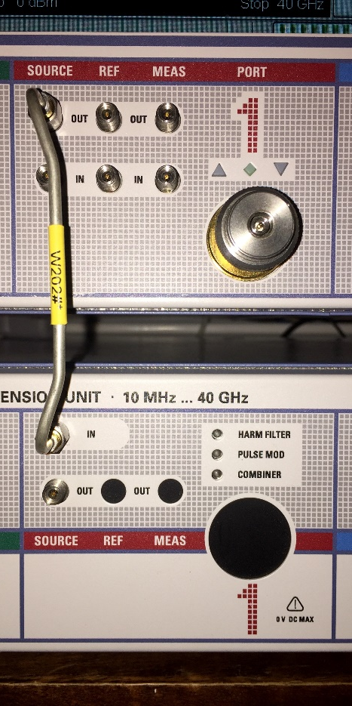
Hardware Configuration
RF Connections
VNA Port 1 Source Out to ZVAX Port 1 In

Slide 6
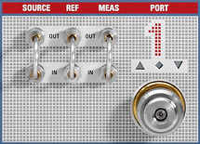
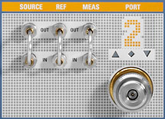
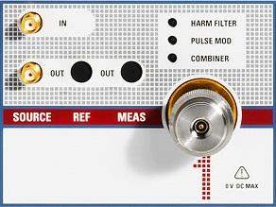
Hardware Configuration
RF Connections
VNA Port 1 Source Out -> ZVAX Port 1 In
VNA Port 1 Ref In, Meas In from couplers
VNA Port 2 Meas In only (or normal port access)
Driver
DUT S(f, P_{in})

Slide 7
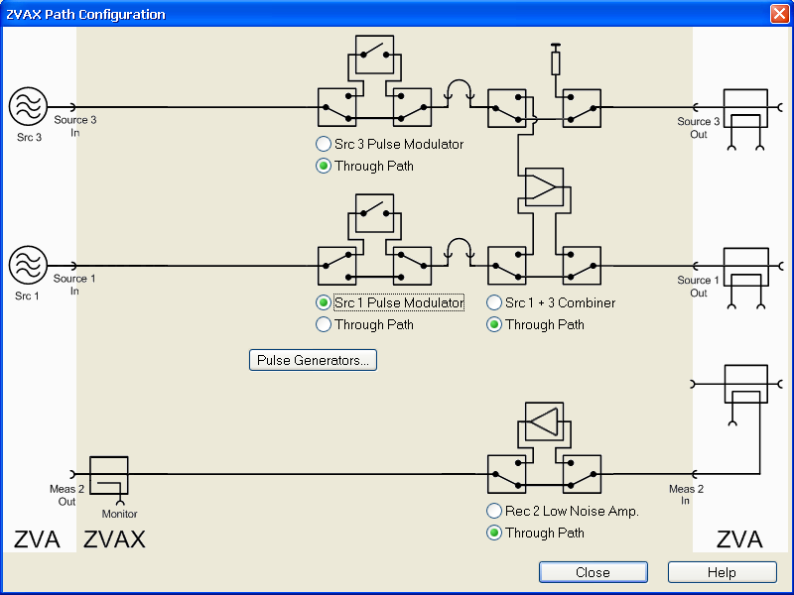
Calibration
Setting up
We will leave the pulse modulator switch in the on position for the cal
Verify that the Src 1 Pulse Modulator is in the ZVAX path
Mode (hard key) -> More (if/as necessary) -> ZVAX Path Config

Slide 8
Calibration
Setting up
You should hear a click (physical switches)
ZVAX Port 1 Pulse Mod should be on

Slide 9
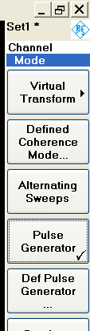
Calibration
Setting up
Mode (hard key) -> Pulse Generator (on, checked)

Slide 10
Calibration
Setting up
Click Def Pulse Generator…

Slide 11
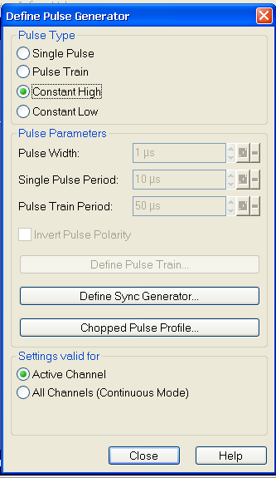
Calibration
Setting up
Pulse Type to Constant High

Slide 12
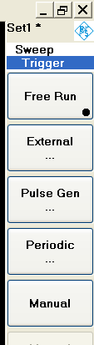
Calibration
Setting up
Sweep (hard key) -> Trigger -> Free Run
At this point the analyzer should be sweeping freely, without pulsing

Slide 13
Calibration
One Path Two Port
Cal (hard key) -> Start Cal -> Two-Port P1 P2 -> One Path Two-Port…
Follow on-screen directions
Port1
Port2
S1
a1
b1
b2
a2
S2
Driver
DUT S(f, P_{in})
ZVAX
Calibration Planes

Slide 14
Calibration
Power Cal
Cal (hard key) -> Start Power Cal -> Source Power Cal…
Port1
Port2
S1
a1
b1
b2
a2
S2
Driver
DUT S(f, P_{in})
ZVAX
Power Cal. Plane

Slide 15
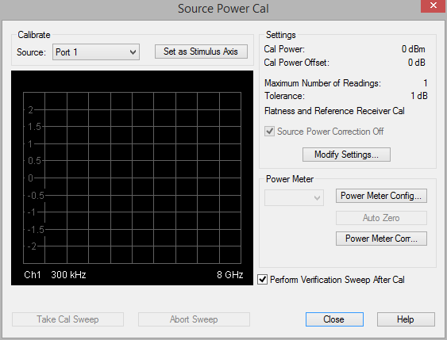
Calibration
Power Cal
Click Modify Settings…

Slide 16
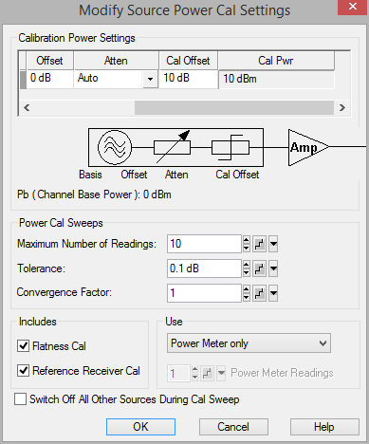
Calibration
Power Cal
Set Cal Offset to gain of driver amplifier
Set Maximum Number of Readings (iterations), Tolerance as appropriate
Include Reference Receiver Cal (Important)
Click OK

Slide 17

Calibration
Power Cal
Auto Zero power sensor (optional)
Take Cal Sweep
With iteration, source should converge on expected values
Close

Slide 18
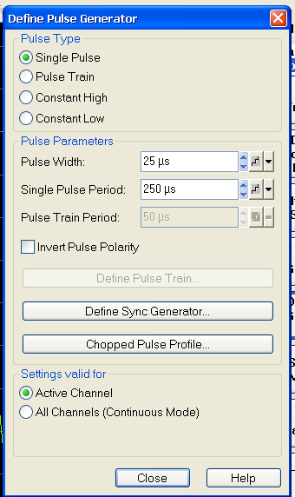
Pulsed RF
Mode (hard key) -> Def Pulse Generator
Set Pulse Type to Single Pulse
Set Pulse Width, Period

Slide 19
Pulsed RF
Note: Pulse width must be longer than sampling time
Reference table:

Slide 20
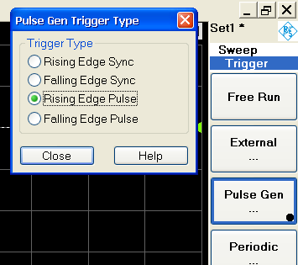
Pulsed RF
Sweep -> Trigger -> Pulse Gen…
Rising Edge Pulse
Pulse Gen... Should be selected

Slide 21
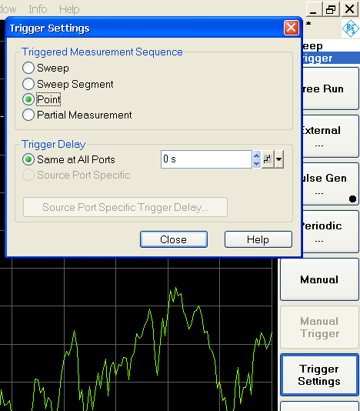
Pulsed RF
Trigger Settings
Triggered Measurement Sequent to Point
Trigger Delay (Optional)

Slide 22
Contact
Greg Bonaguide Senior Product Line Engineer
Spectrum Analyzers
Vector Network Analyzers
Northeastern Region
+1 (774) 2820028 greg.bonaguide@rsa.rohde-Schwarz.com
Nick Lalic VNA Software Developer
San Francisco, CA
+1 (424) 200-2846 nick.lalic@rsa.rohde-schwarz.com
http://vna.rs-us.net
Phone Support: +1 (888) TEST-RSA

